Slide 1

School of Technology, Design and Computer Application Silver Oak College of Compter Application
Department of Computer Application
A PROJECT PRESENTATION ON
E-Learning
Submitted By
Rajput Rishu . (En. No.: 2204030101130)
Bachelor of Computer Application Semester VI
Group No: 286
Guide
Ms. Shailee Patel
Submitted To
Department of Computer Application
Silver Oak University, Gota, Ahmedabad, 382481 Academic Year 2024-2025

Slide 2
1. PROJECT PROFILE
Project Profile: | Facilitates online education management and delivery.
Objective: | Enable flexible online learning. Enhance educational experiences. Facilitate communication and collaboration. Provide data-driven insights for decision-making.
Platform of Application: | Web base Application
Front End Tool: | HTML, CSS, JavaScript, React.js
Back End Tool: | Node.js/MongoDB
Project Duration : | 6 Months
Project Guide : | Mrs. Shailee Patel
Submitted By : | Rajput Rishu : 2204030101130
Submitted To : | Department Of Computer Science
2

Slide 3
2. EXISTING SYSTEM
The LMS may lack personalization features, resulting in a one-size-fits-all approach that fails to cater to
individual learning preferences and needs.
The LMS may lack interactive and engaging learning experiences, replying primarily on static content delivery methods such as text-based lectures and readings.
Implement personalization features that allows users to customize their learning experience based on preferences such as course recommendations, content filters, and learning pathways.
Integrate interactive elements such as multimedia content, simulations, gamification, discussion forums, and collaborative activities to enchance learner engagement and participant .
3

Slide 4
3. NEED FOR NEW SYSTEM
Implement personalization features that allows users to customize their learning experience based on preferences such as course recommendations, content filters, and learning pathways.
Integrate interactive elements such as multimedia content, simulations, gamification, discussion forums, and collaborative activities to enchance learner engagement and participant .
Website | UI & UX | Easy Navigation | Any Charges | Secure
gsaauctions.gov |  | ✔ | ✔ | ✔
webstore.com |  |  | ✔ | ✔
atomicmall.com |  |  | ✔
sothebys.com | ✔ | ✔ | ✔ | ✔
E-Learning.com | ✔ | ✔ |  | ✔
4

Slide 5
FUNCTIONAL SPECIFICATION
4.1 USER OF THE SYSTEM
Admin:-
The admin can login into system by entering some credentials.
The admin can manage all bids.
The admin can manage all the products.
The admin can manage all users.
The admin can see all the product and bid reports.
5

Slide 6
4. FUNCTIONAL SPECIFICATION
4.1 USER OF THE SYSTEM
User:-
The User has to register on website to access online lectures, video lecture .
The User can login on the website and check their progress day to day.
The User can check their progress by giving exams .
6

Slide 7
4. FUNCTIONAL SPECIFICATION
4.1 USER OF THE SYSTEM
3) Instructor:-
The Instructor has to register on website by giving some information.
The Instructor can login on the website by providing some personal information.
The Instructor can upload their videos and Courses.
The Instructor can teach multiple courses .
The Instructor can teach multiple courses but each course is typically taught by only one instructor.
7

Slide 8
4. FUNCTIONAL SPECIFICATION
4.2 MODULE OF THE SYSTEM
Registration :-
The User and Instructor can register on the website.
Login:-
The User , Instructor and admin can login on the website.
Manage User:-
Admin can manage all user but User and Instructor can only manage their own profile.
Manage Courses:-
The admin can manage all Courses and the Quiz can manage their own product.
8

Slide 9
5. SYSTEM REQUIREMENT
5.1 MINIMUM SOFTWARE REQUIREMENT
Server Side Requirement
Operating System | Window Server 2003 or Any Compatible Server OS
Web Server | APACHE
Front-End Tools | HTML, CSS, JavaScript, React.js
Back-End Tool | Node.js/MongoDB
Client Side Requirement
Operating System | Window XP or Any Compatible OS
Web Browser | Google Chrome or Any Compatible Browser
9

Slide 10
5. SYSTEM REQUIREMENT
5.2 MINIMUM HARDWARE REQUIREMENT
Server Side Requirement
Processor | 2.8 GHz
RAM | 2 GB
Hard disk | 4 GB(Free Space)
Client Side Requirement
Processor | 1.33 GHz
RAM | 2 GB
Hard disk | 4 GB(Free Space)
10

Slide 11
6. SYSTEM FLOWCHART
11

Slide 12
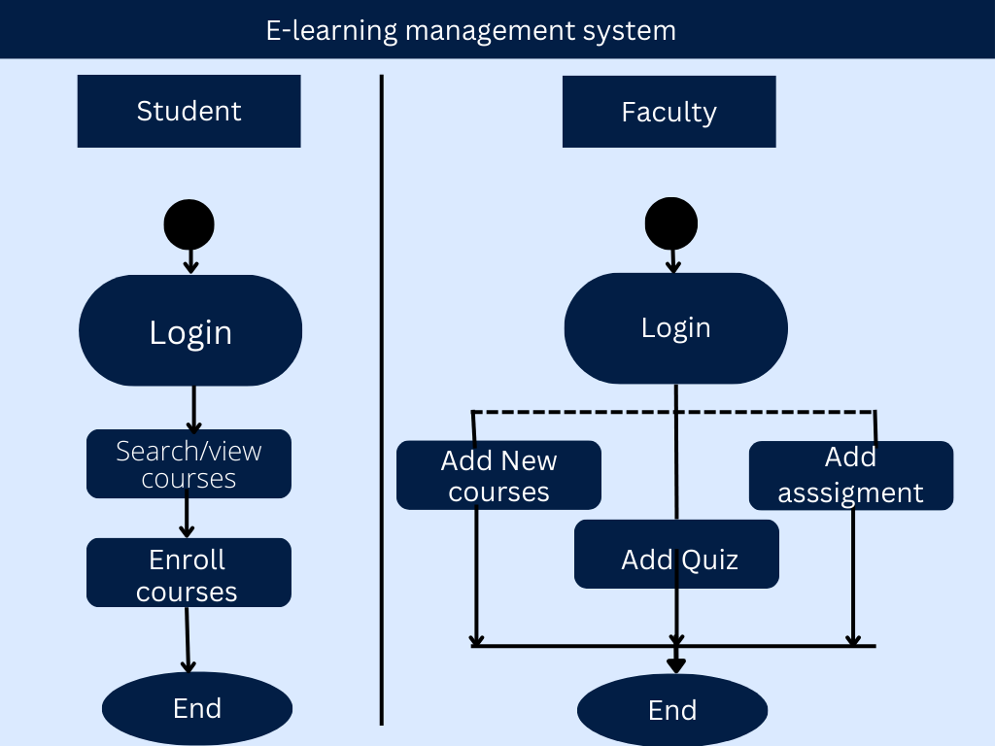
12

Slide 13
7. ER DIAGRAM
13

Slide 14
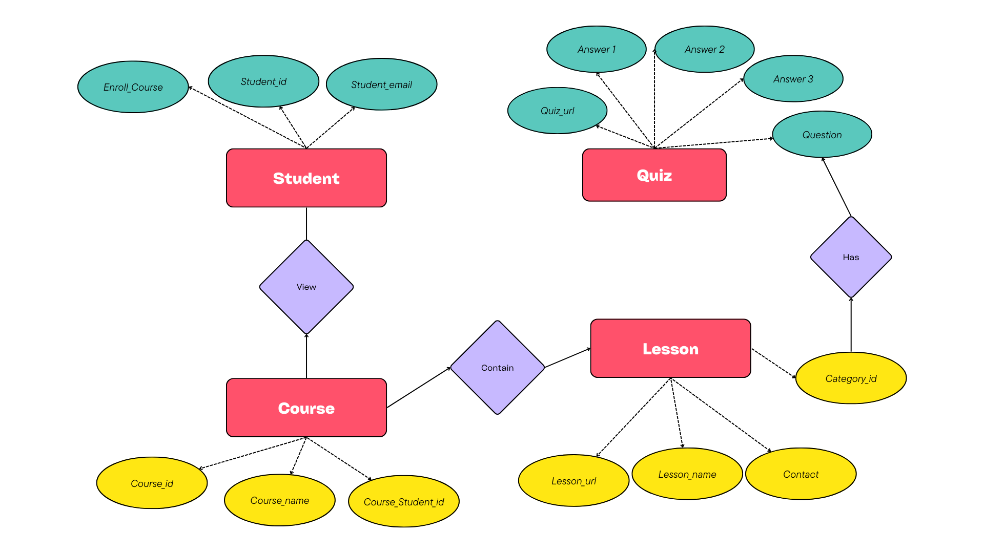
14

Slide 15
8. DATAFLOW DIAGRAM
15

Slide 16
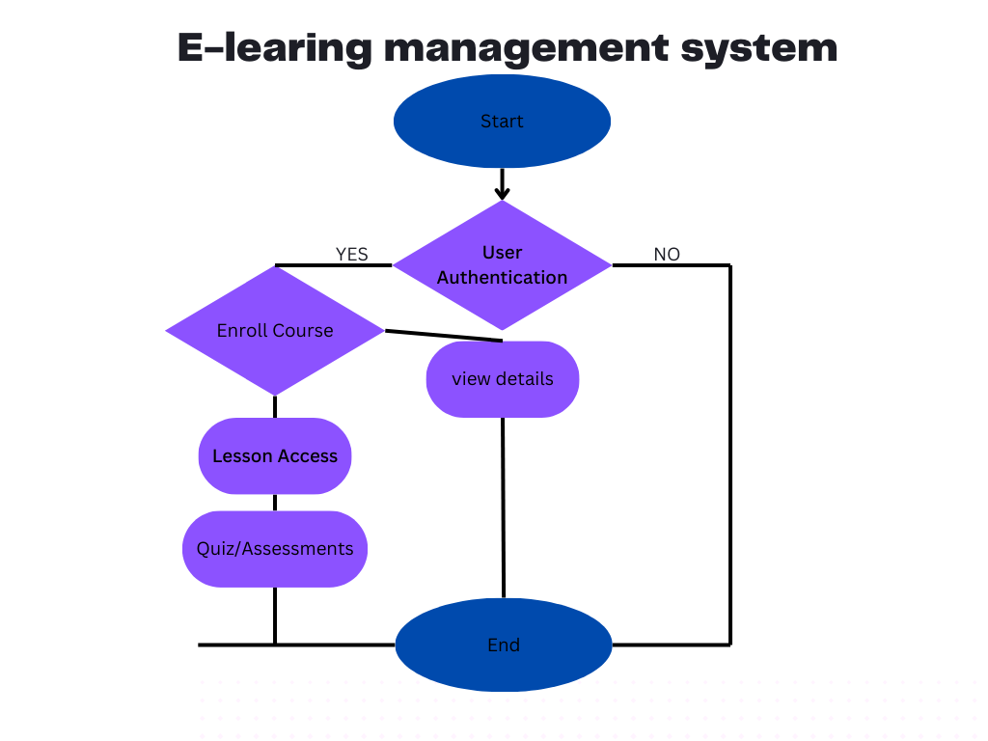
8. DATAFLOW DIAGRAM
16

Slide 17
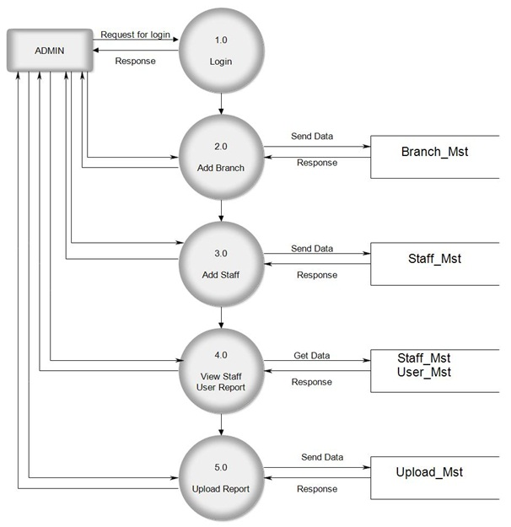
8.2 FIRST LEVEL DFD
17

Slide 18
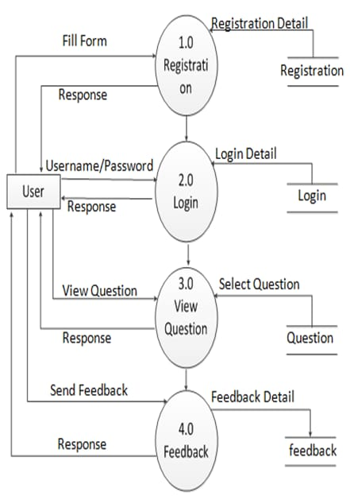
FIRST LEVEL DFD AUCTIONEER SIDE
18

Slide 19
9. DATA DICTIONARY
TABLE NAME
users
Instructor
bids
pwd_reset
19

Slide 20
Users
Table Name : - | users
Primary Key : - | user_id
Description : - | To store user information
Sr. No | Field Name | DataType(Size ) | Constraint | Description | Sample Data
1 | user_id | Int (3) | Primary Key | To store user_id.& id is Auto Increm ent. | 101
2 | username | Varchar (50) | Not Null | To store the Username. | My Username
3 | user_email | Varchar (50) | Not Null | To store the User’s Email. | myemail@gmail.com
4 | user_password | Varchar (150) | Not Null | To store the User’s Passw--ord. | $2y$10$5v0DlzDlSXfyExAB dHr/dOe…
5 | user_image | Text | Not Null | To store the User’s Image path. | user_image.jpg
6 | user_phone | Int(10) | Not Null | To store the User’s Phone number. | 9675465756
7 | user_role | Varchar (15) | Not Null | To store the User’s Role. | admin

Slide 21
Instructor
Table Name : - | Instructor
Primary Key : - | Instructor_id
Foreign Key :- | Instructor_user_id (Ref – users (user_id))
Description :- | To store Instructor Information in Details.
Sr. No | Field Name | DataType (Size) | Constraint | Description | Sample Data
1 | instructor_id | Int(3) | Primary key | To store the instructor_id. & Id is Auto Increment. | 1
2 | instructor_name | Varchar(50) | Not Null | To store the instructor name. | Laptop
3 | instructor_desc | Text | Not Null | To store the instructor description. | This laptop is very fast.
4 | instructor_price | Int(10) | Not Null | To store the instructorprice. | 1234
5 | instructor_image | Text | Not Null | To store the instructor image path. | newimage.jpg

Slide 22
6 | instructor_create_date | date | Not Null | To store the instructor created date | 2021-12-02
7 | instructor_status | Varchar (10) | Not Null | To store the instructor status. | Active
8 | instructor_user_id | Int (3) | Foreign Key | To store the instructor user id. | 15
9 | instructor | Int (3) | Not Null | To store instructor’s Id. | 12

Slide 23
Quiz
Table Name : - | quiz
Primary Key : - | quiz _id
Foreign Key :- | quiz _instructor_id (Ref – products(product_id)) & bid_user_id(Ref – users(user_id))
Description :- | To store information of all quiz.

Slide 24

10. INPUT DESIGN

Slide 25
10.1 INPUT DESIGN FOR ADMIN SIDE

Slide 26
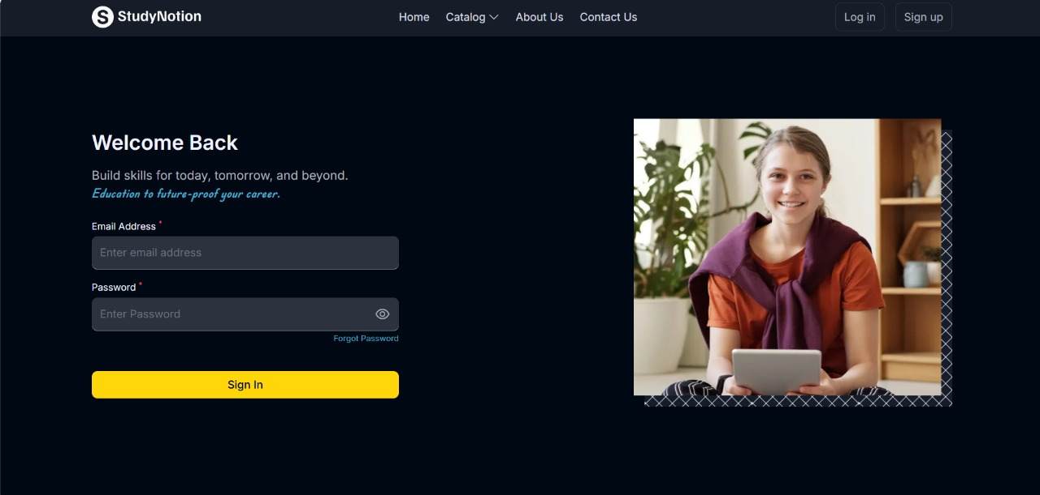
Login page
Description: - It is login page. Admin can login by providing information.

Slide 27
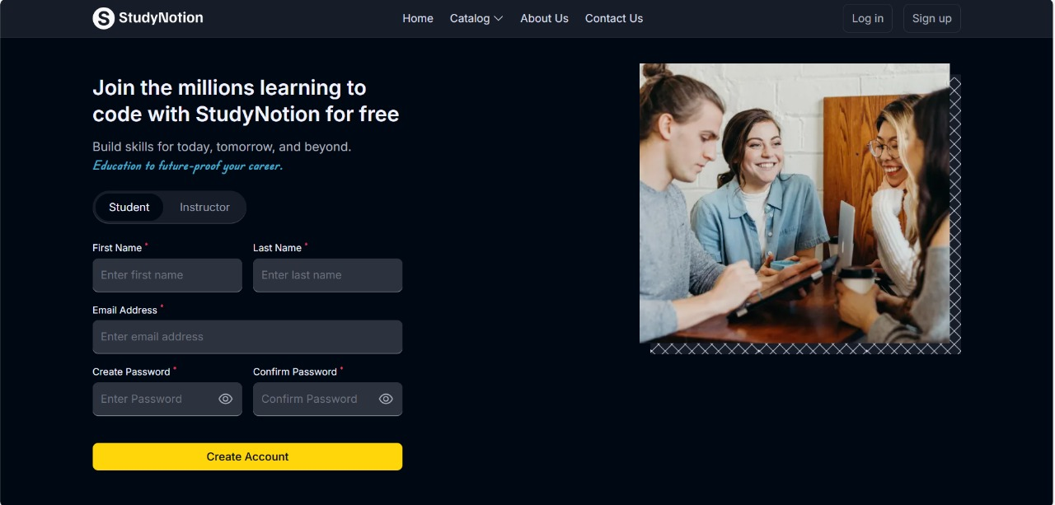
Signup page with Student
Description: - It is login page with validation. If any field is empty then login page will give one error message as popup.

Slide 28
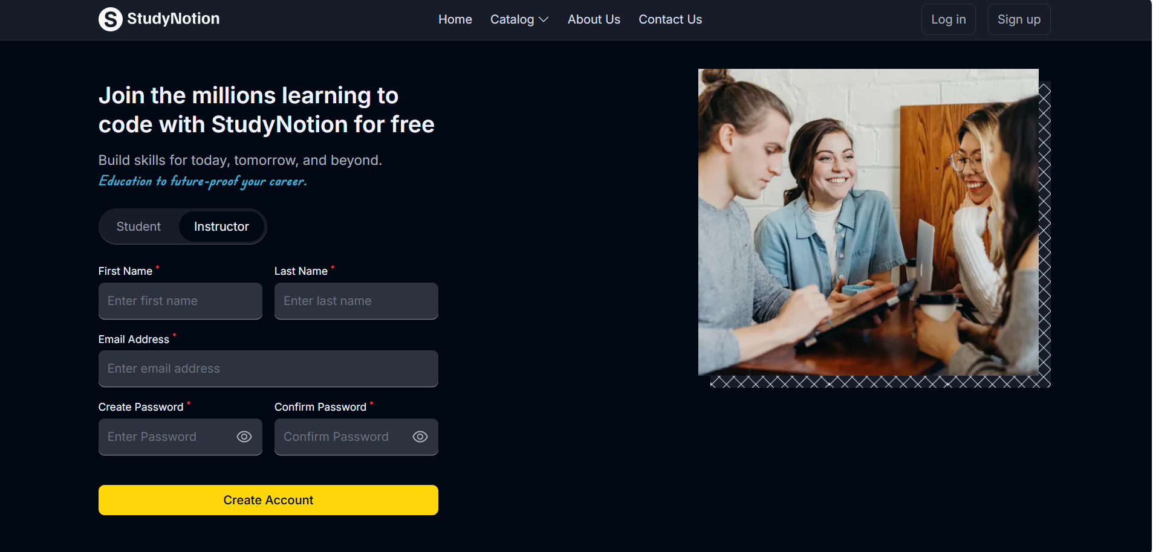
Signup page with Instructor
Description: - It is add product page. Admin can add product by click on “add product” button and providing product information.

Slide 29
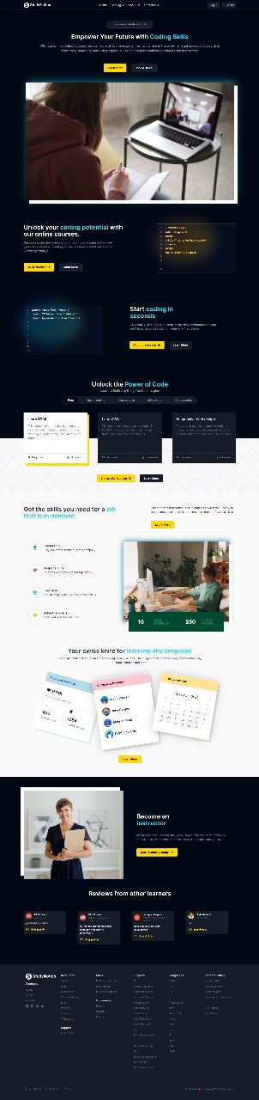
Home page

Slide 30
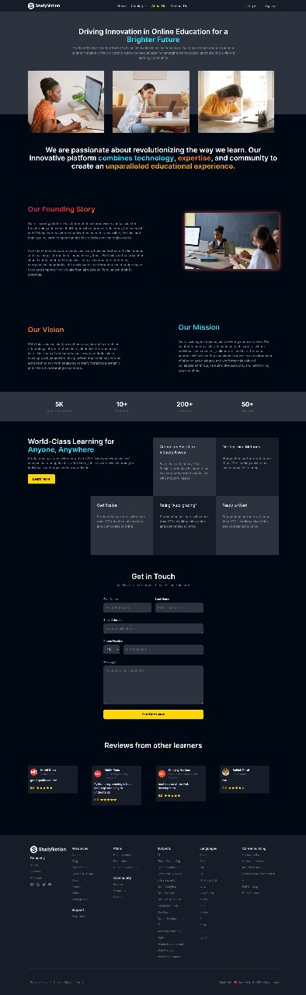
Edit product page

Slide 31
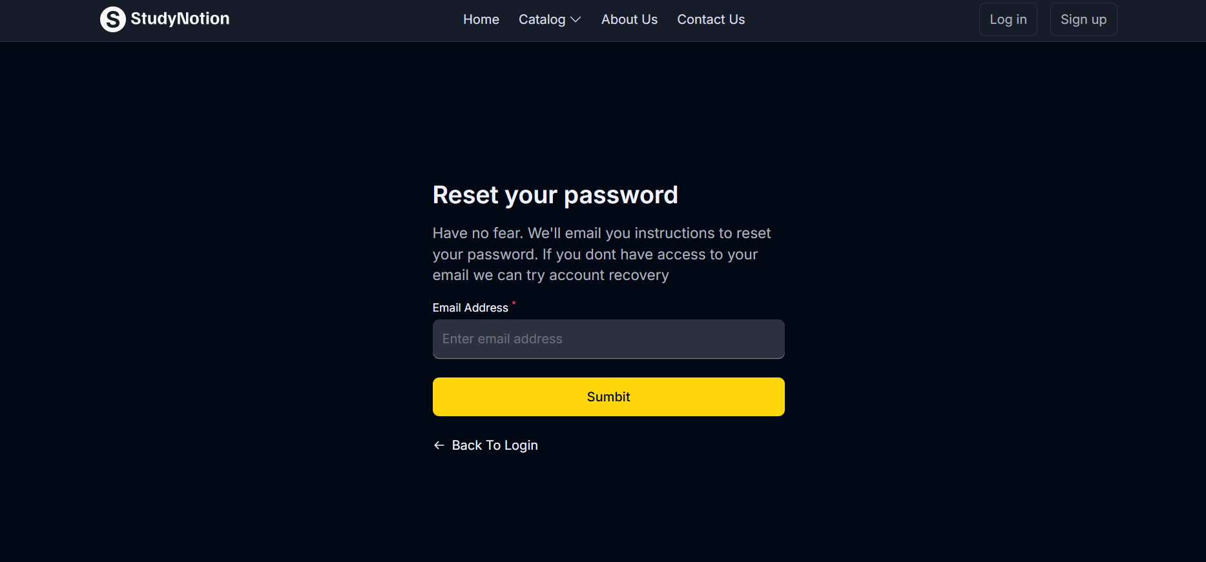
Forgot password page

Slide 32
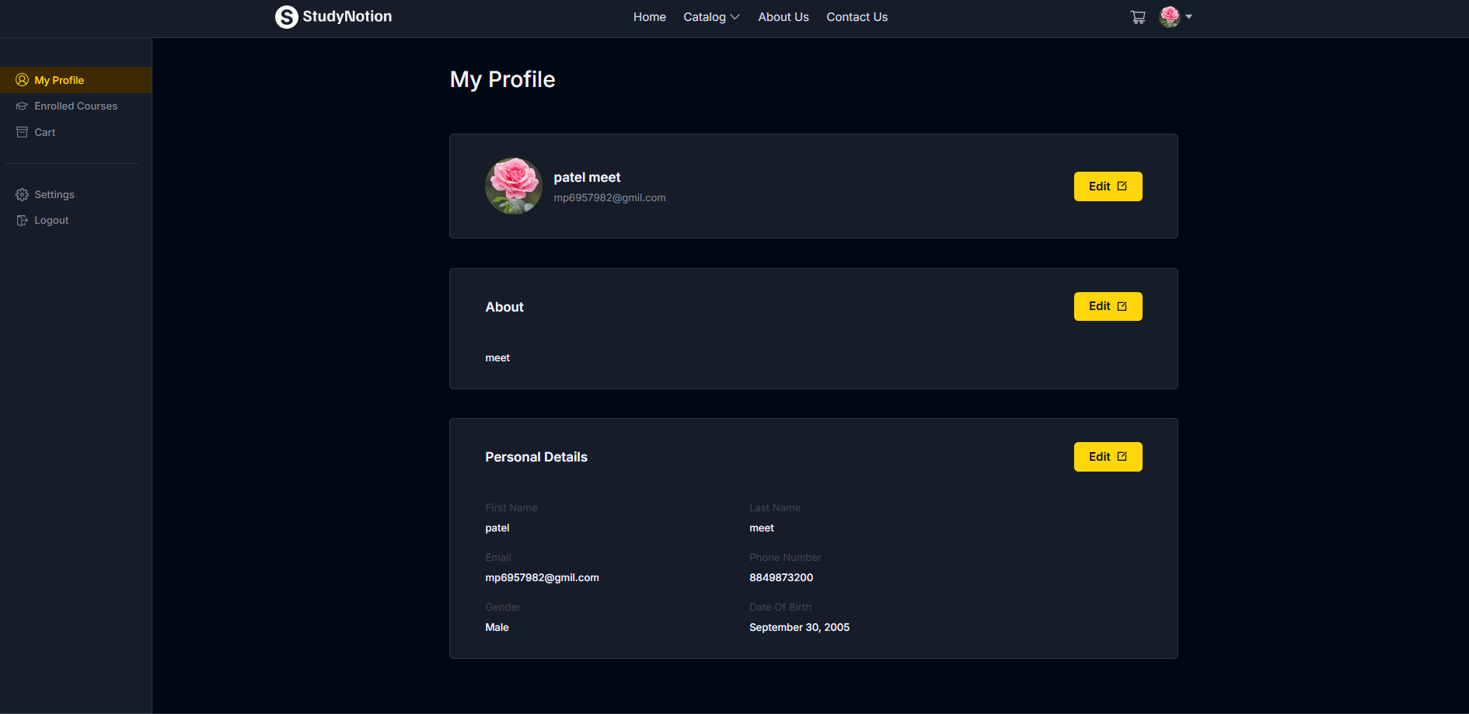
Profile page

Slide 33
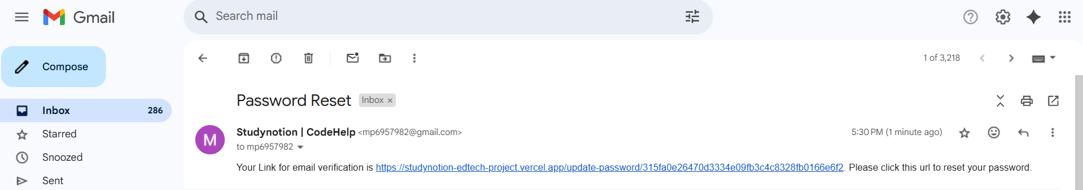
Forget password link sent to email

Slide 34
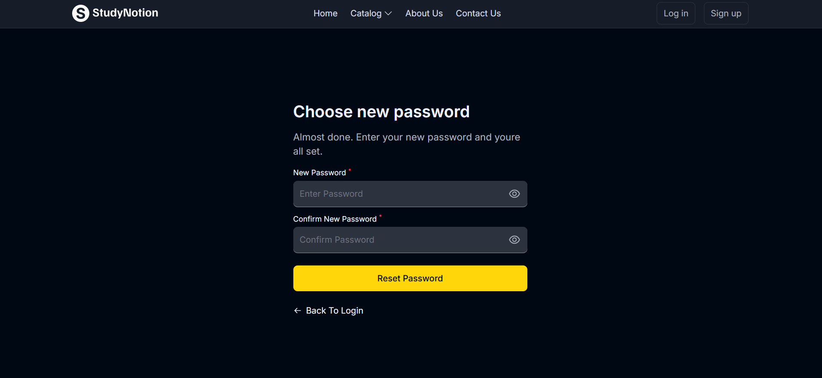
Reset password page

Slide 35
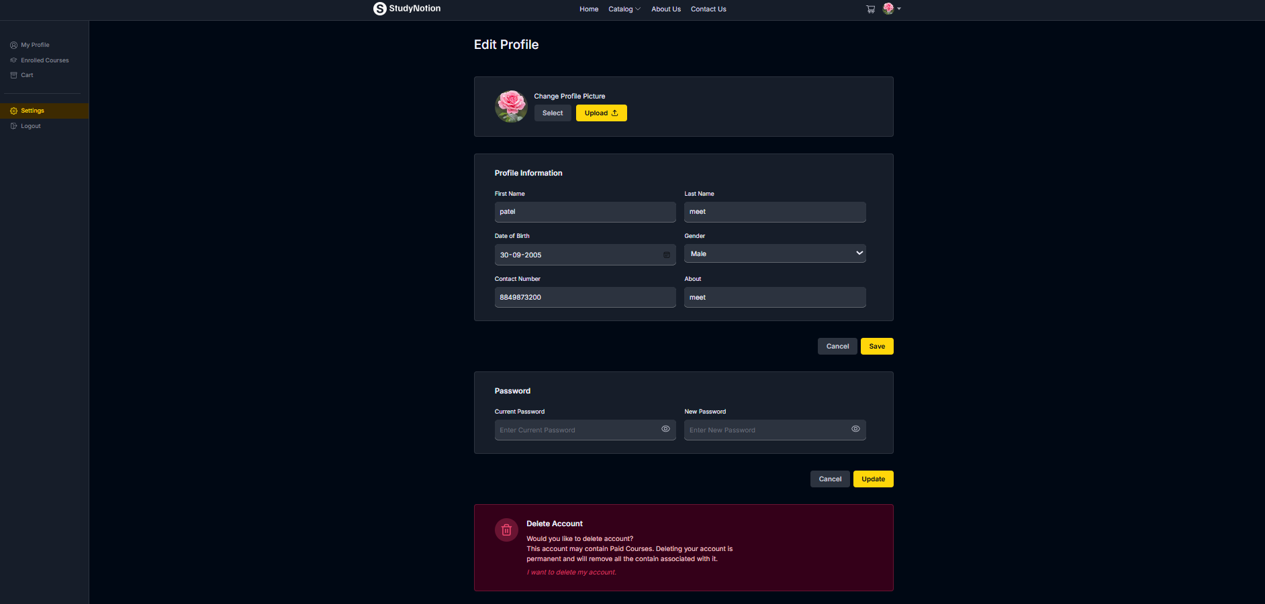
Update profile page

Slide 36
12. TESTING
No. | Test Condition | Description | Expected Result | Actual Output | Status
1 | Registration | Click on sign up button without Username | System will display validation message | System display message like “All fields are required” | Pass
 |  | Click on sign up button without Email | System will display validation message | System display message like “All fields are required” | Pass
 |  | Click on sign up button with invalid mobile number | System will display validation message | System display message like “Enter valid phone number” | Pass
 |  | Click on sign up button with all valid input data | System will register a new user | System display message like “Registration successful” | Pass

Slide 37
No. | Test Condition | Description | Expected Result | Actual Output | Status
2 | Login | Non-Registered user | System will not allow Non-Registered user to login | System will display validation message like “Can’t find user” | Pass
 |  | Click on login button with invalid email and password | System will not allow user to login | System will display validation message like “Invalid login details” | Pass
 |  | Click on login button with valid email and password | System will allow to login | System will display validation message like “Login successful” | Pass

Slide 38
No. | Test Condition | Description | Expected Result | Actual Output | Status
3. | Forget Password | Click on reset password button without email | System will display validation message | System display message like “Email is required” | Pass
 |  | Click on reset password button with wrong email | System will display validation message | System display message like “Email doesn't exist!” | Pass
 |  | Click on reset password button with valid email | System will allow to send reset link to email | System display message like “Reset password link send to email” | Pass

Slide 39
No. | Test Condition | Description | Expected Result | Actual Output | Status
4. | Add Course | Click on add Course button without course amount and user is logged in as bidder. | System will display validation message | System display message like “Please enter your Course amount” | Pass
 |  | Click on add Course button without / with Course amount and user is not logged in as bidder | System will display validation message | System display message like “You have to be logged in as bidder to add Course” | Pass
 |  | Click on add Course button with bid amount and user is logged in as bidder | System will allow to add bid | System display message like “Course added successfully” | Pass

Slide 40
No. | Test Condition | Description | Expected Result | Actual Output | Status
5. | Update Profile | Click on update button without email | System will display validation message | System display message like “All fields are required” | Pass
 |  | Click on update button without phone number | System will display validation message | System display message like “All fields are required” | Pass
 |  | Click on update button with invalid phone number | System will display validation message | System display message like “Enter valid phone number” | Pass
 |  | Click on update button with valid input data | System will allow to update profile | System display message like “User updated successfully” | Pass

Slide 41
13. FUTURE ENHANCEMENT
Introduce AI algorithms to recommend personalized course paths based on user behavior, preferences, and progress.
Enable real-time video classes using tools like Zoom or WebRTC, allowing instructors to teach live.
Launch a fully responsive mobile app for iOS and Android to increase accessibility and reach.
Offer content in multiple languages to cater to a broader global audience.
Allow users to interact in forums, ask questions, and form study groups within the platform.

Slide 42
14. BIBLIOGRAPHY
OLMS: Online Learning Management System for E-Learnin https://eric.ed.gov/?id=EJ1161611
Design and Development E-Learning System by Learning Management System (LMS) in Vocational Education
https://eric.ed.gov/?id=ed605316

Slide 43
THANK YOU

